Slide 1

Columbus - School of AI
09/27/2018

Slide 2

School of AI
What’s School of AI?
An International School dedicated to studying, teaching, and creating Artificial Intelligence to help solve the Worlds Most difficult problems.
Who’s the Director?
Siraj Raval – He lives to serve all Wizards[the shared moniker of the community]. Inspiring, educating, and guiding them along their journey to help them maximize their positive impact in the world using AI Technology

Slide 3
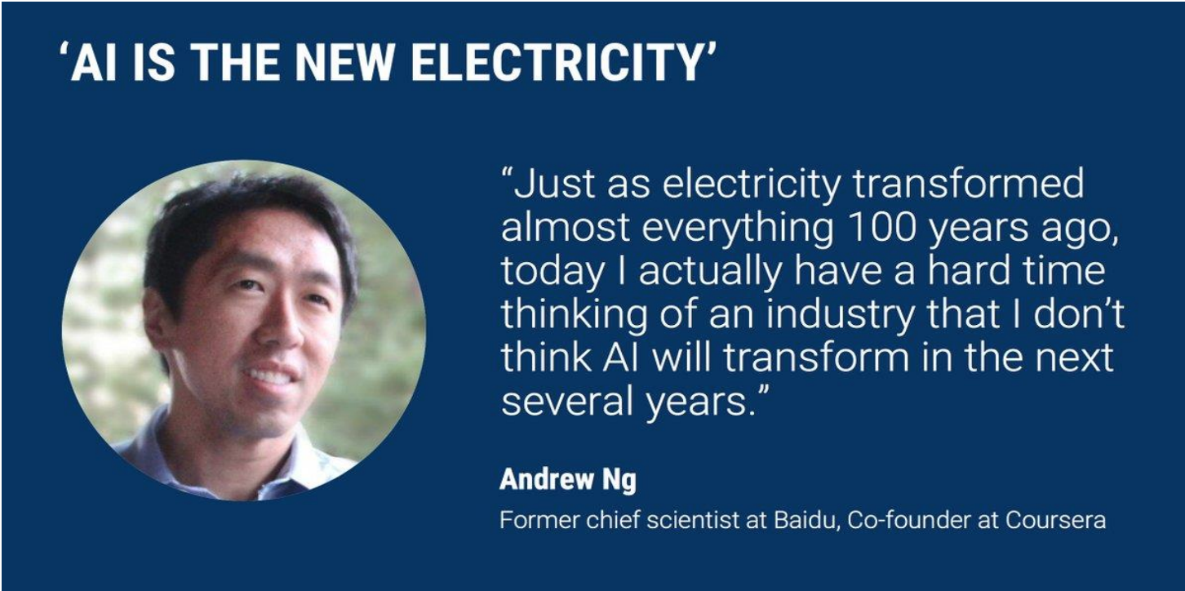
AI is the New Electricity

Slide 4
Artificial Intelligence
What is AI
Artificial Intelligence is a way to make machines think and behave intelligently.
Machines understand the World and accordingly react to situations in the same way that Humans do
AI is closely related to the study of Human Brain.

Slide 5
Why do we need to study AI?
AI has the ability to impact every aspect of our lives.
The field of AI tries to understand patterns and behaviors of entities.
With AI, we want to build smart systems and understand the concept of intelligence as well.
The intelligent systems that we construct are very useful in understanding how an intelligent system like our brain goes about constructing another intelligent system.

Slide 6
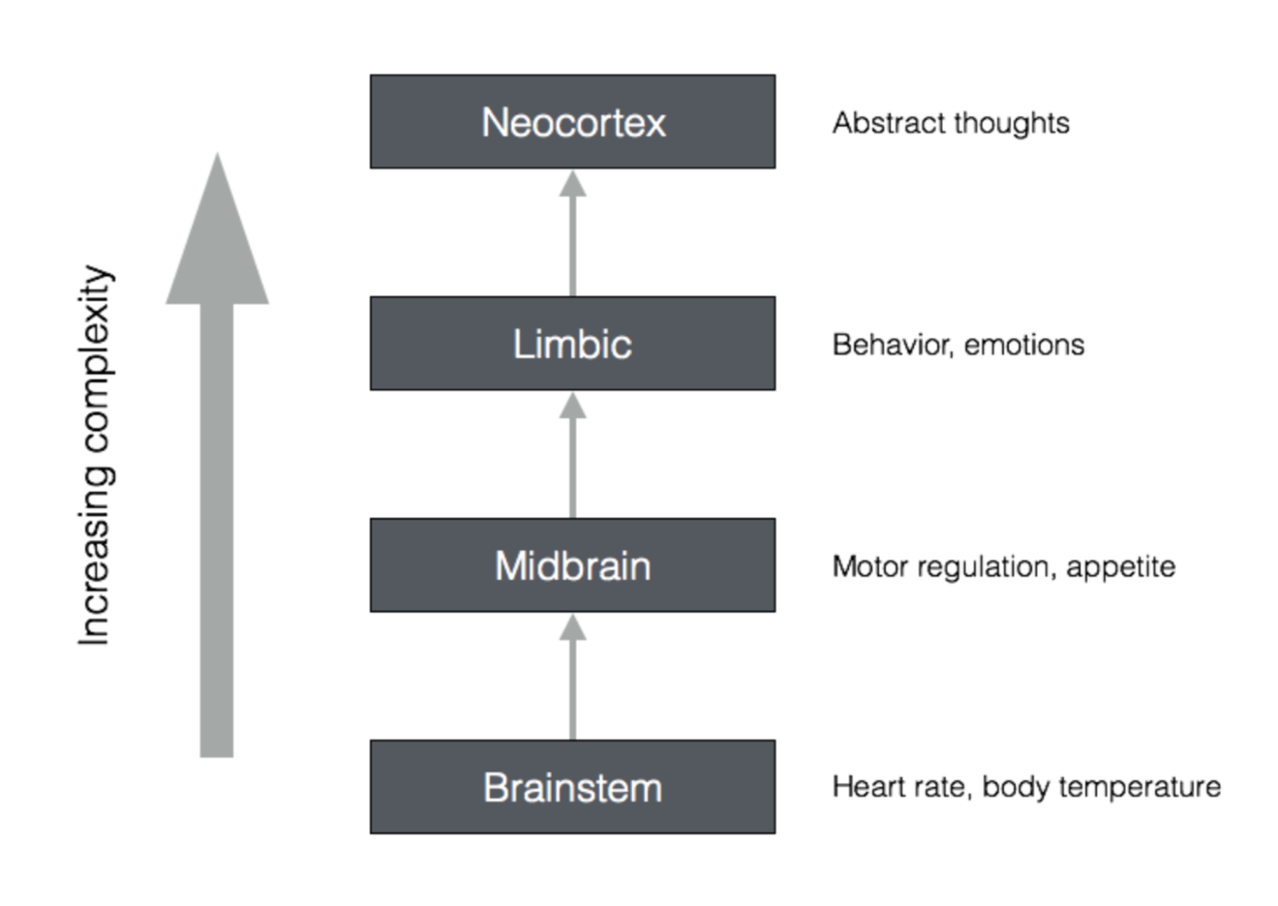
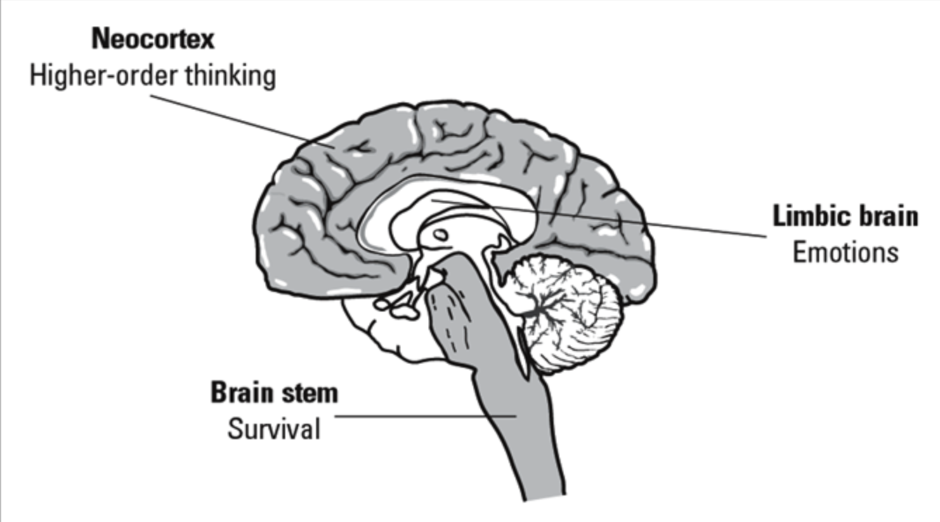
How Brain Thinks

Slide 7
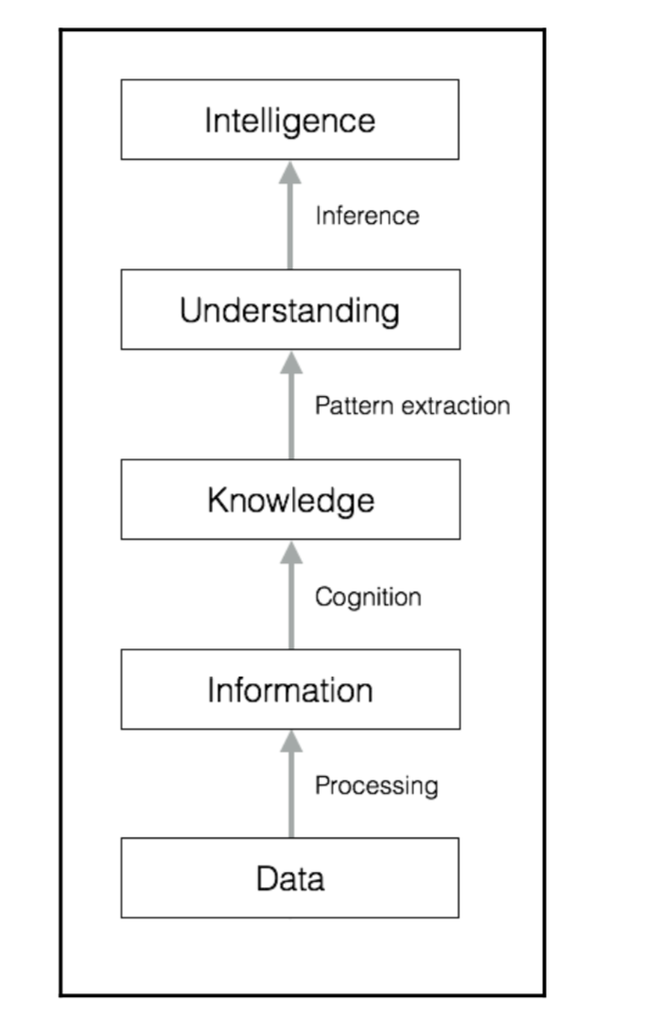
How AI Thinks

Slide 8
Applications of AI
Computer Vision
Natural Language Processing
Speech Recognition
Expert Systems
Games
Robotics

Slide 9
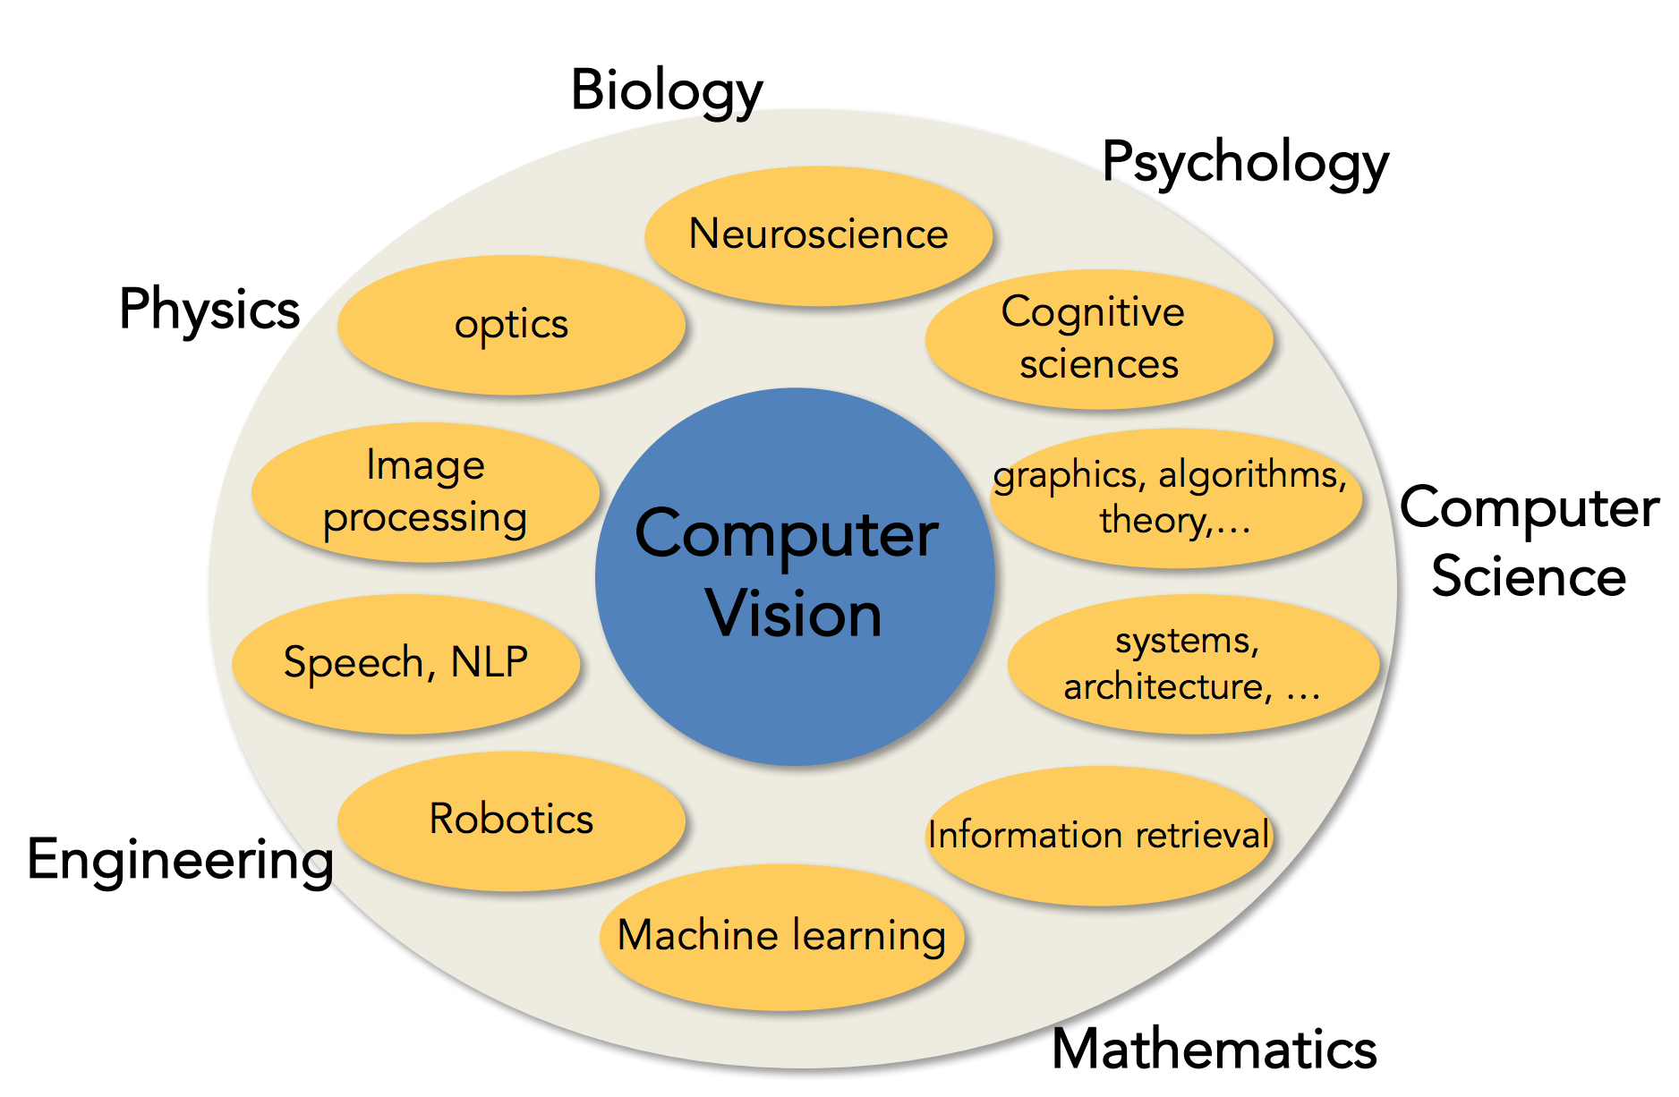
Computer Vision

Slide 10
Natural Language Processing
Spell checking, keyword search, finding synonyms
Extracting information from websites such as
product price, dates, location, people or company names checking, keyword search, finding synonyms
Machine translation
Spoken dialog systems
Complex question answering
Automated/assisted translation
Sentiment analysis for marketing or finance/trading
Speech recognition
Chatbots / Dialog agents

Slide 11
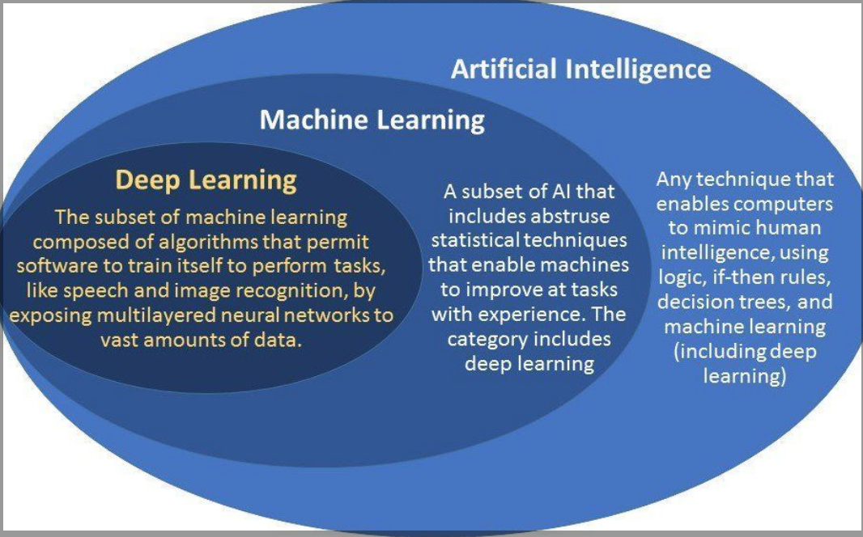
AI / ML / DL

Slide 12
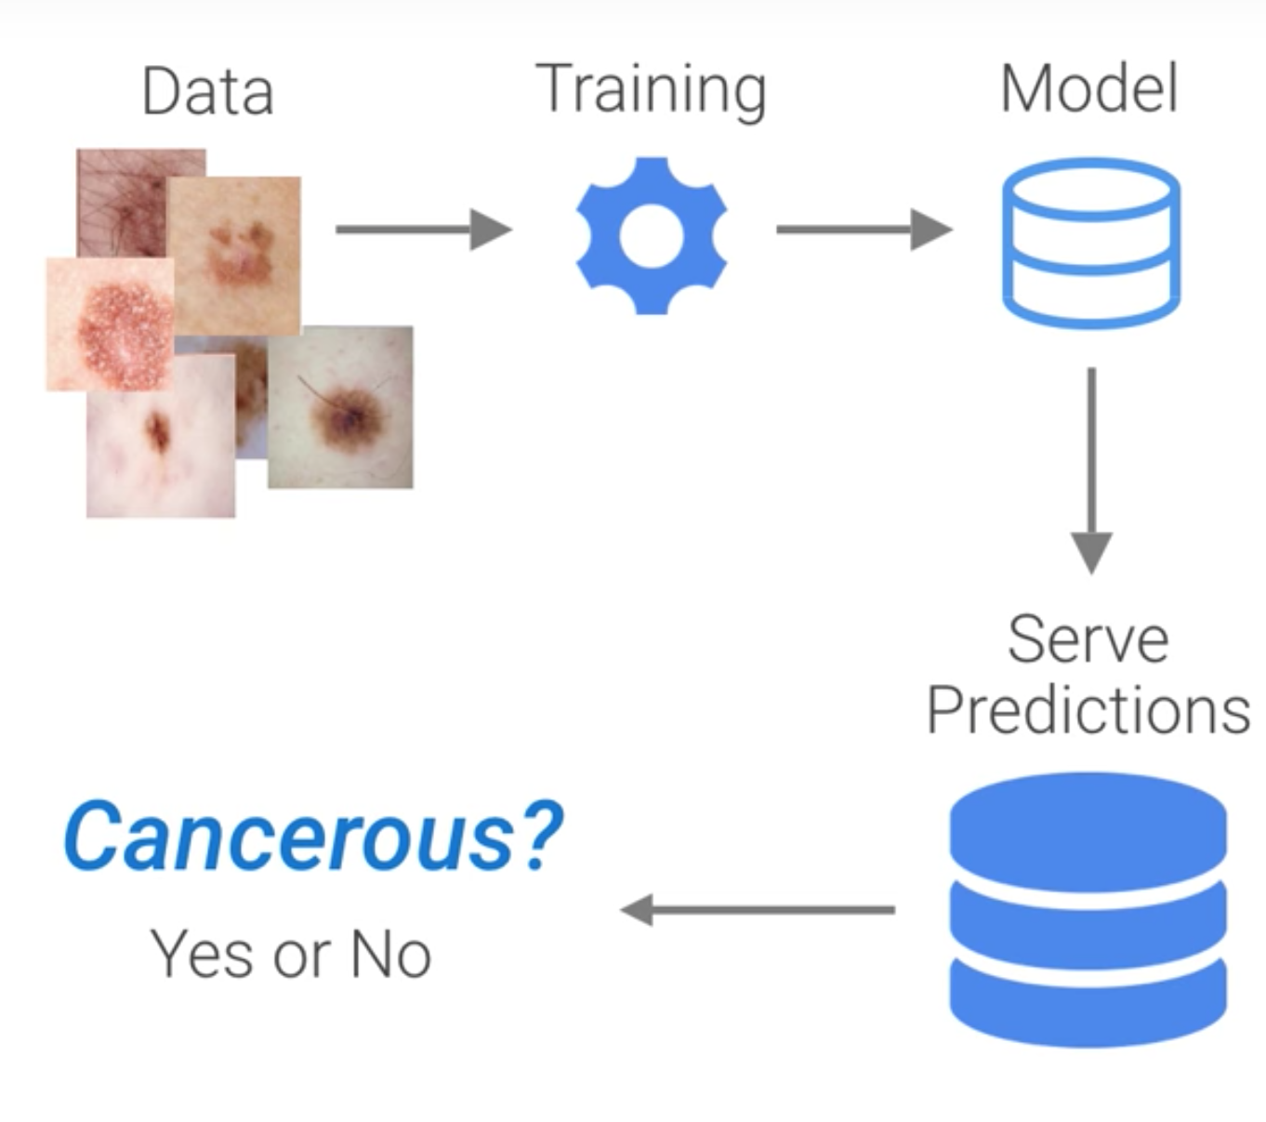
Machine Learning
Using Data to Answer Questions
Training Prediction
Using Answer
Data Questions

Slide 13
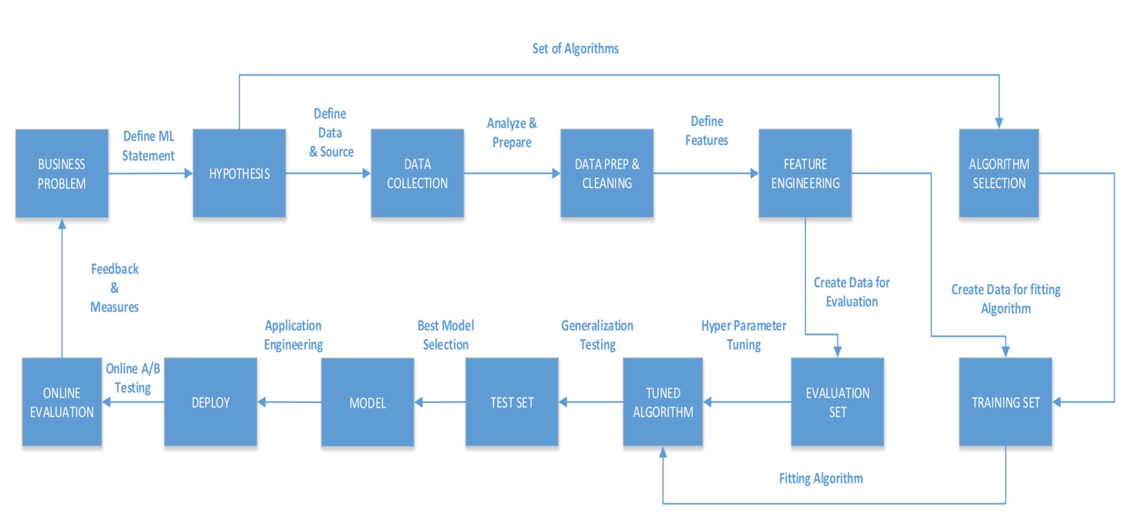
Machine Learning Process Flow

Slide 14
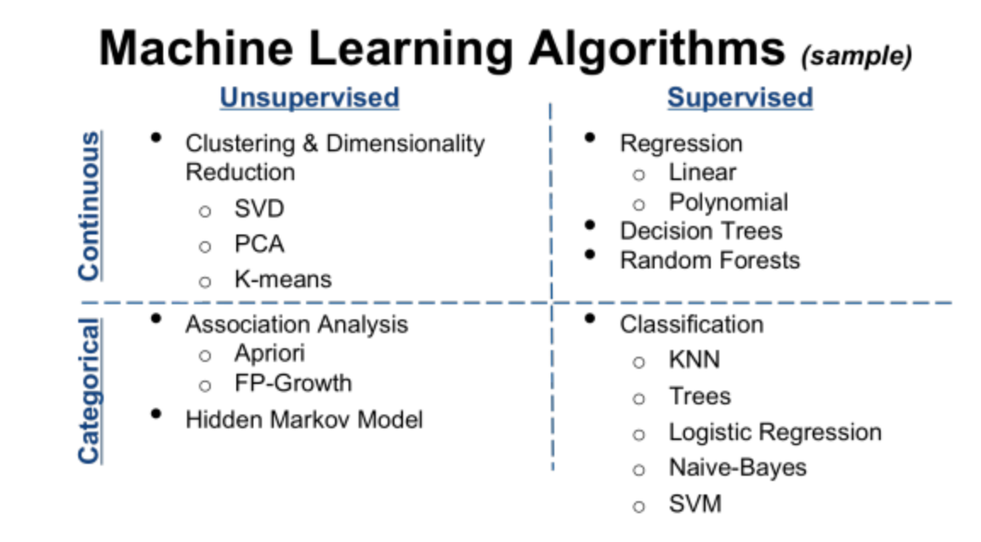
Machine Learning Algorithms

Slide 15
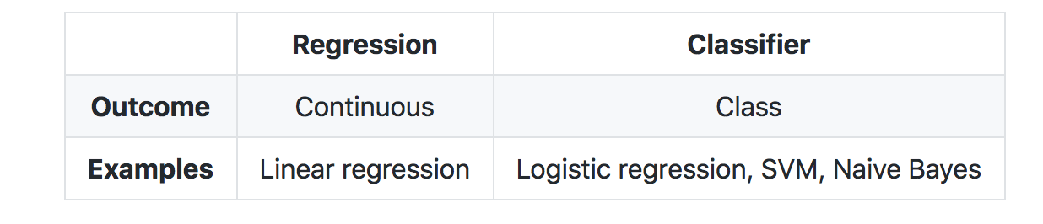
Machine Learning – Supervised Learning
Supervised Learning
Given a set of data points {x(1),...,x(m)} associated to a set of outcomes {y(1),...,y(m)}, we want to build a classifier that learns how to predict y from x.
Type of prediction ― The different types of predictive models are summed up in the table below:

Slide 16
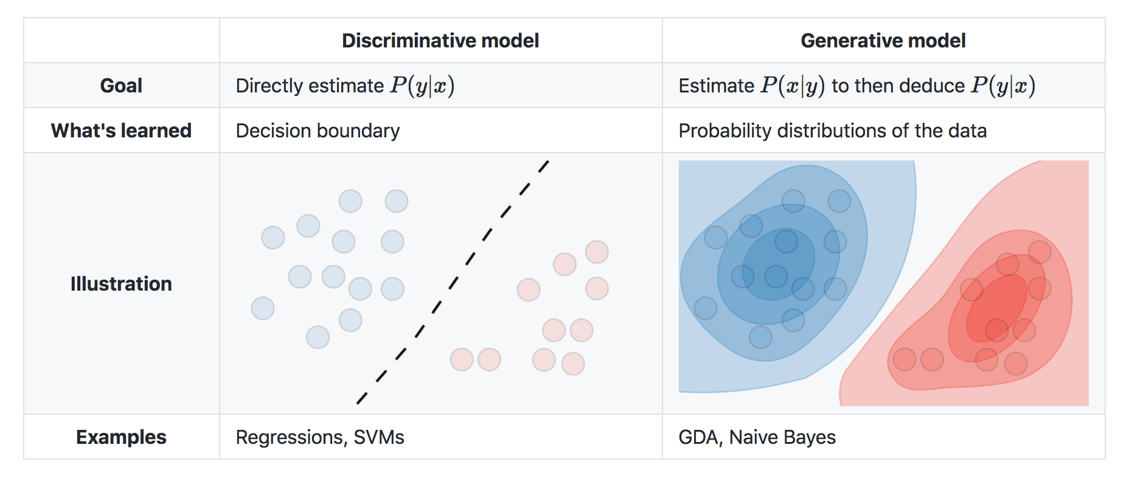
Machine Learning – Supervised Learning
Type of Model ― The different models are summed up in the table below:

Slide 17
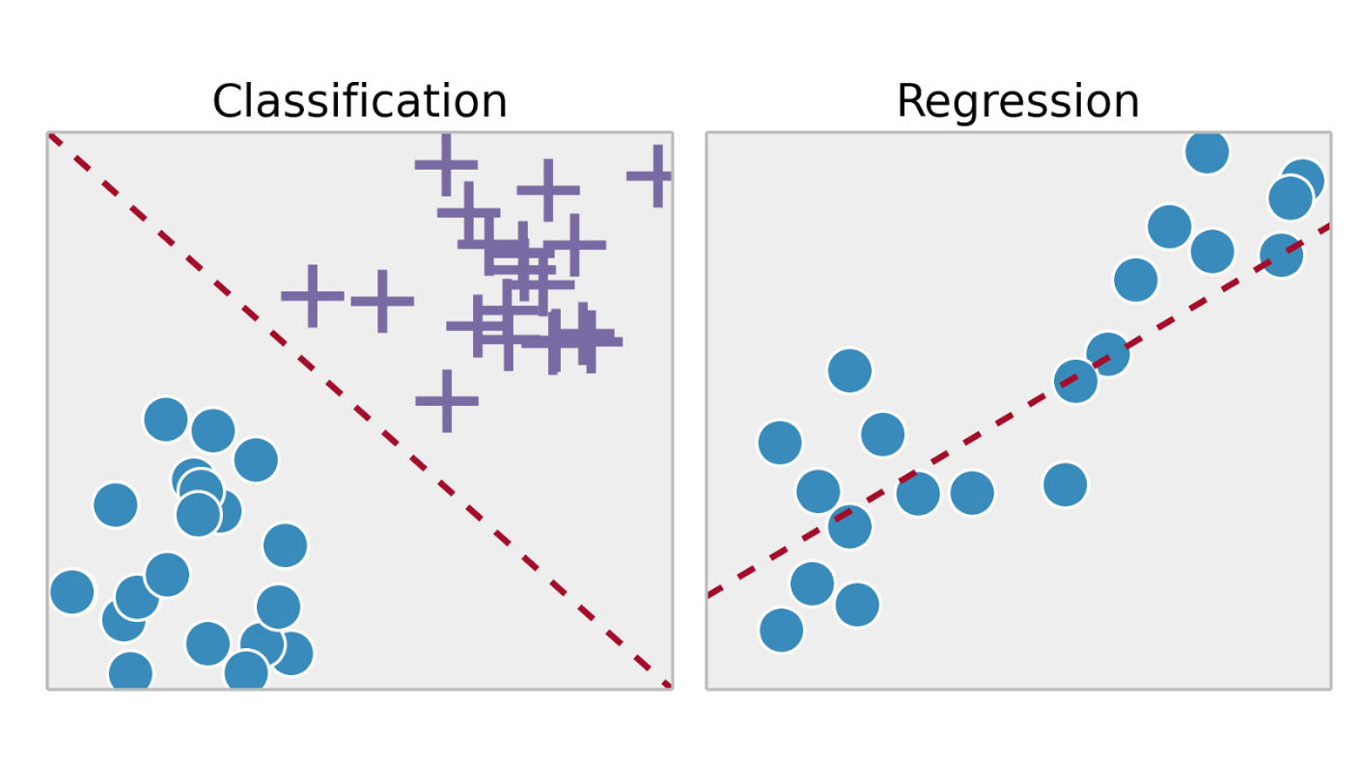
Supervised Learning

Slide 18
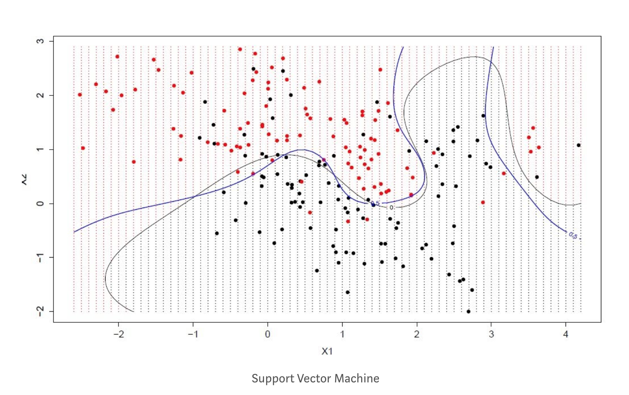
ML Algorithm – Support Vector Machines

Slide 19
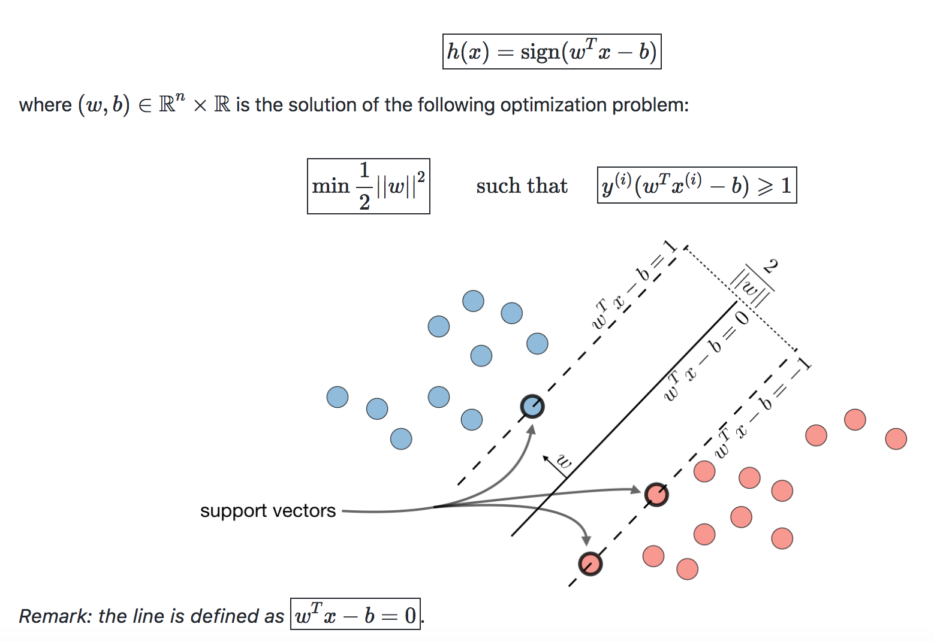
Support Vector Machines
The goal of support vector machines is to find the line that maximizes the minimum distance to the line
Optimal margin classifier – The optimal margin classifier ’h’ in such that:
Notes:
Classification and Categorical

Slide 20
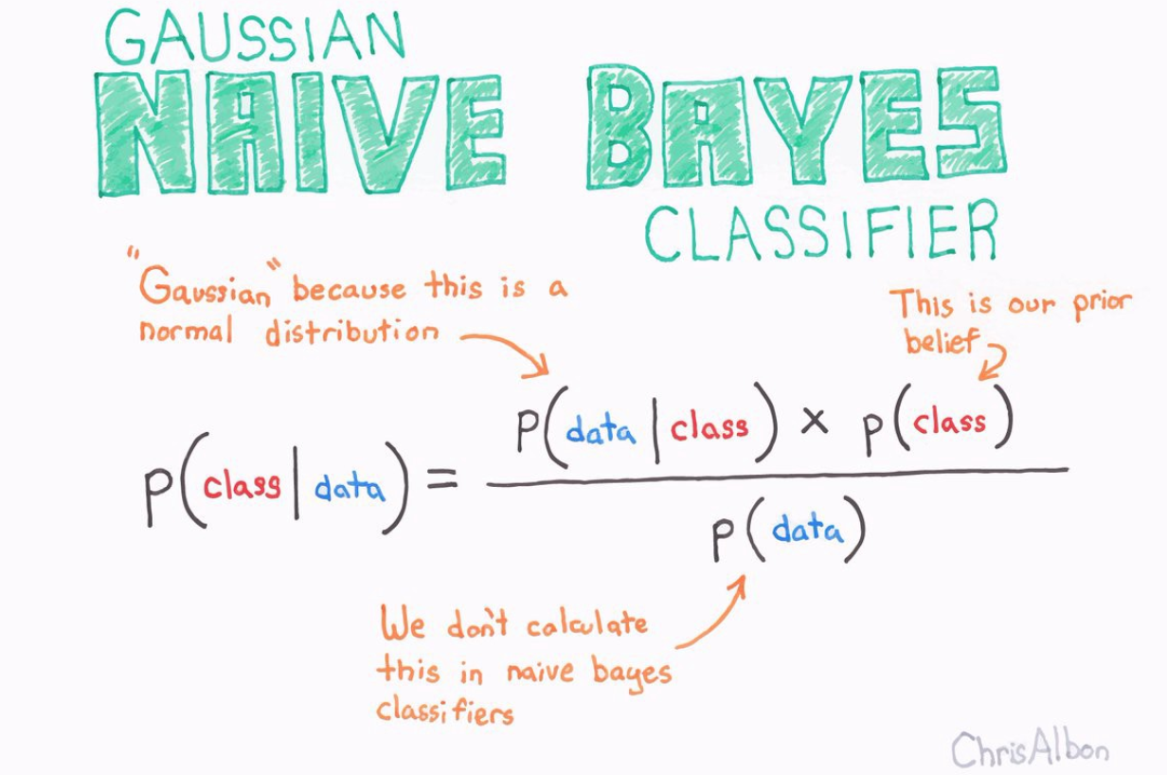
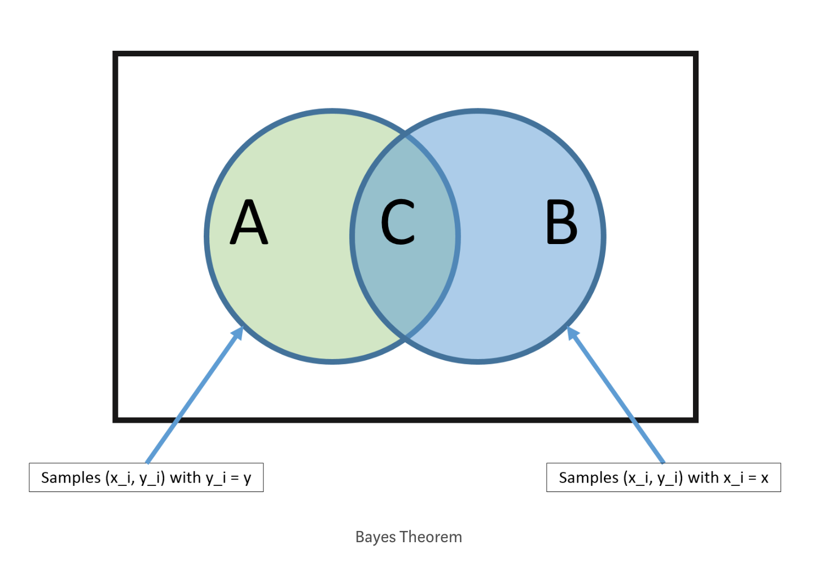
ML Algorithm – Naïve Bayes
Notes:
Naive Bayes model is easy to build and particularly useful for very large data sets. Along with simplicity, Naive Bayes is known to outperform even highly sophisticated classification methods.

Slide 21
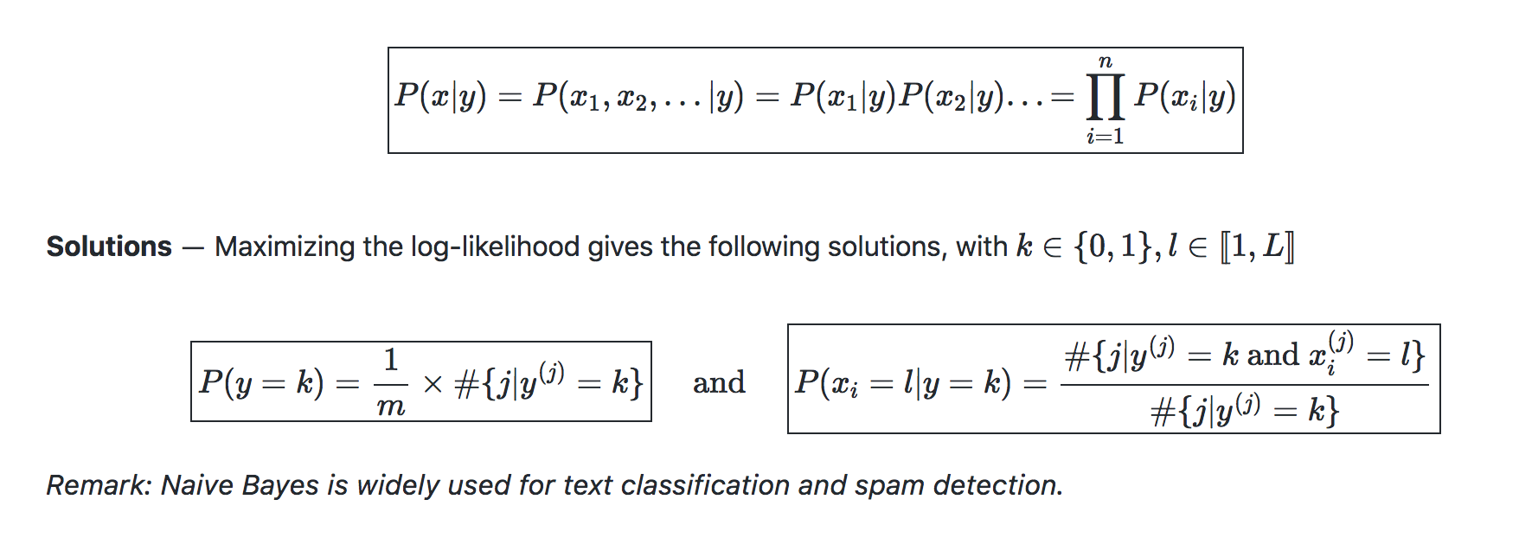
Naïve Bayes
Assumption – The Naïve Bayes model supposes that the feature of each data point are all independent.

Slide 22
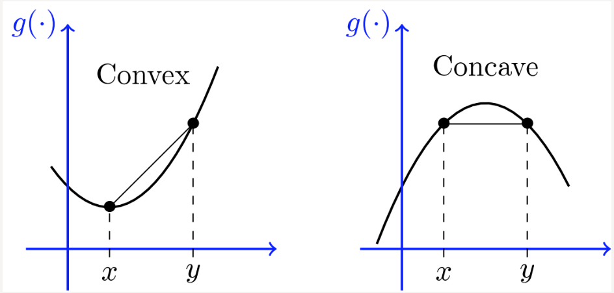
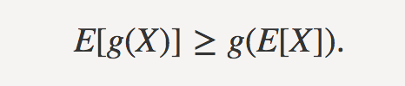
Machine Learning – Unsupervised Learning
The goal of unsupervised learning is to find hidden patterns in unlabeled data {x(1),...,x(m)}.
Jensen's inequality ― Let g be a convex function and X a random variable. We have the following inequality:

Slide 23
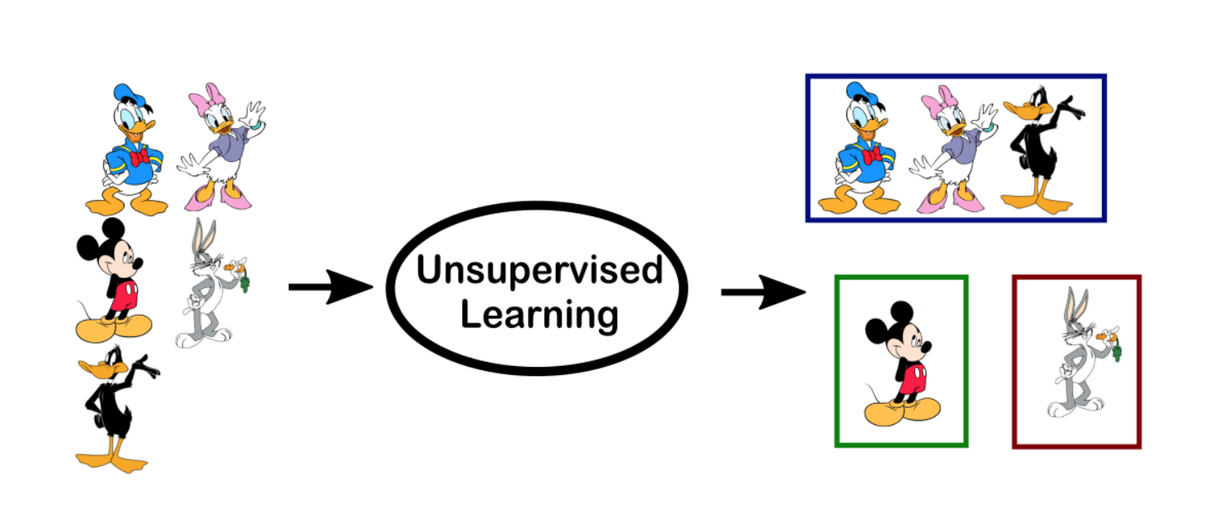
Unsupervised Learning

Slide 24
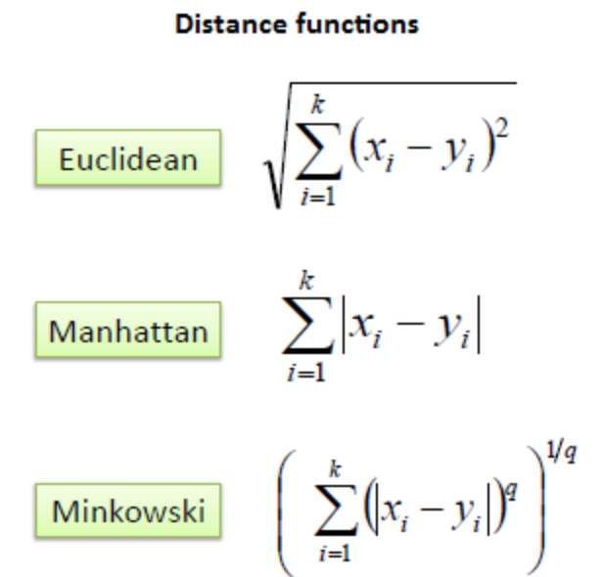
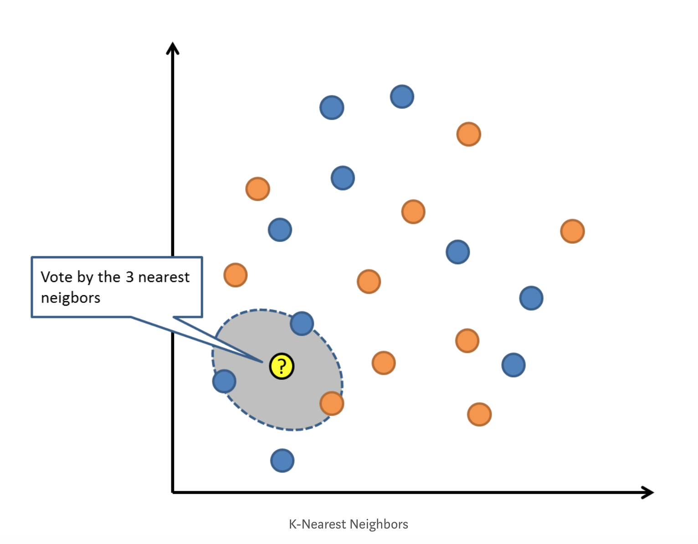
ML Algorithm – K – Nearest Neighbors

Slide 25
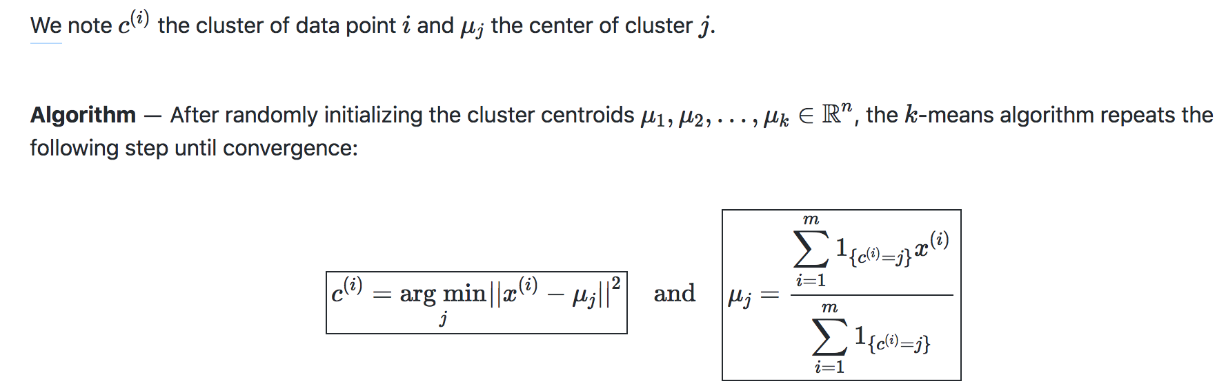
Unsupervised Learning – k-means Clustering
The

Slide 26
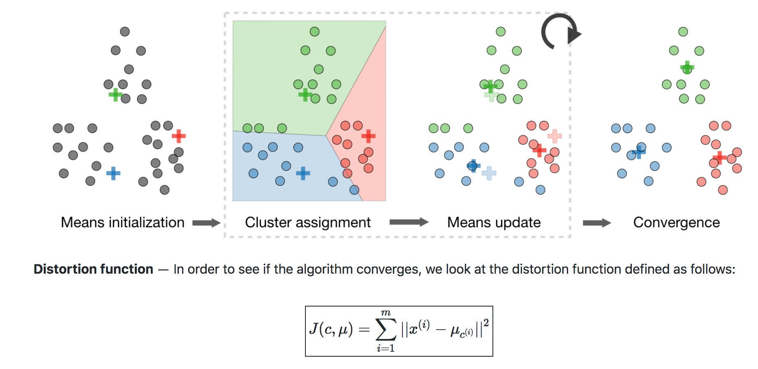
Unsupervised Learning – k-means Clustering
The

Slide 27
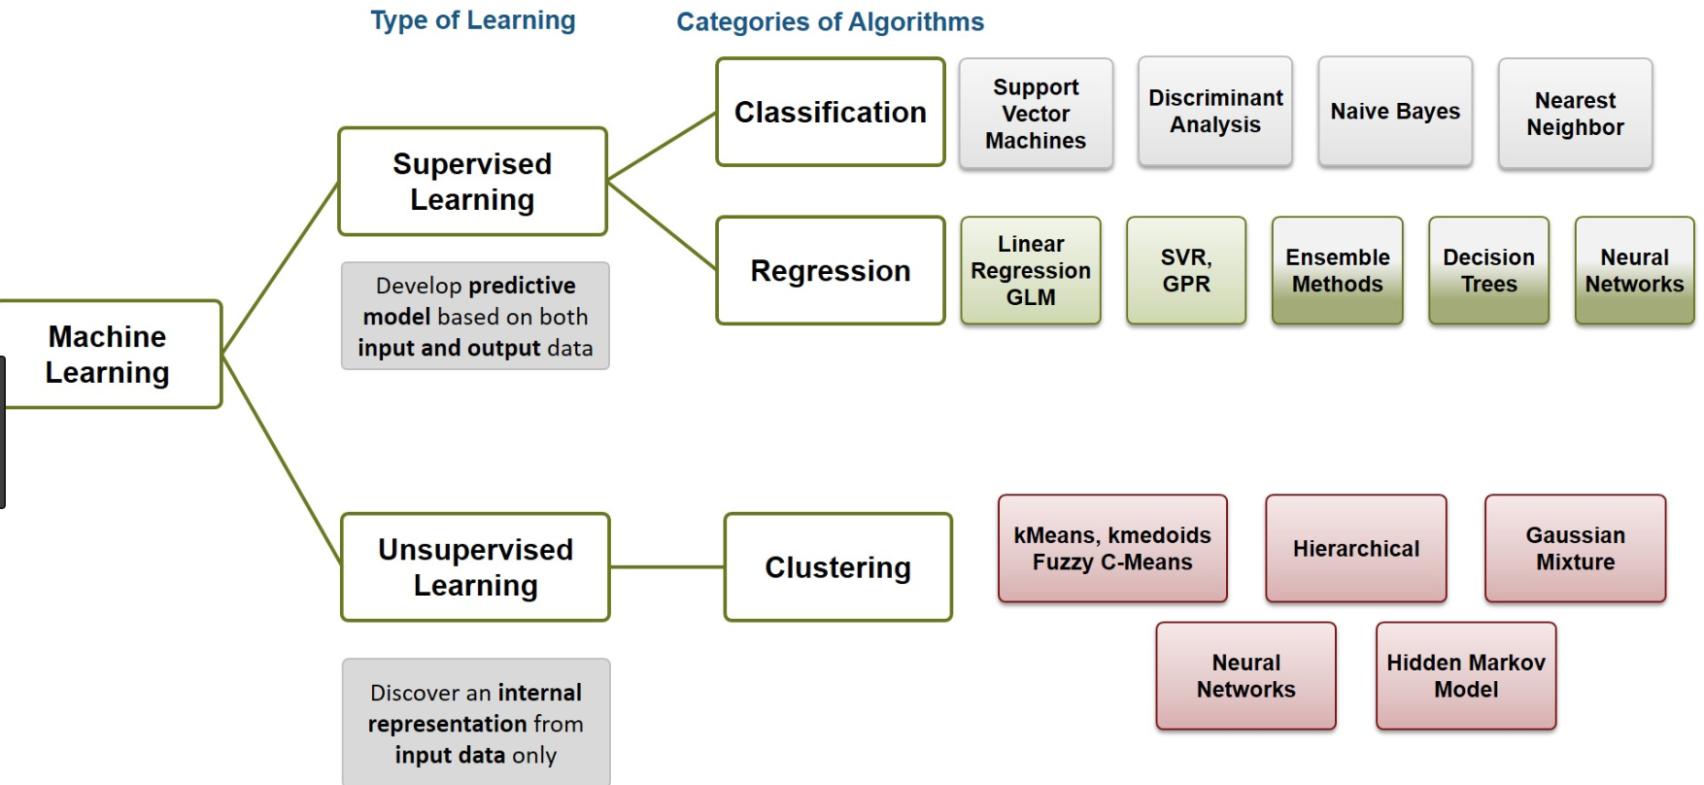
Supervised Learning Vs Unsupervised Learning

Slide 28
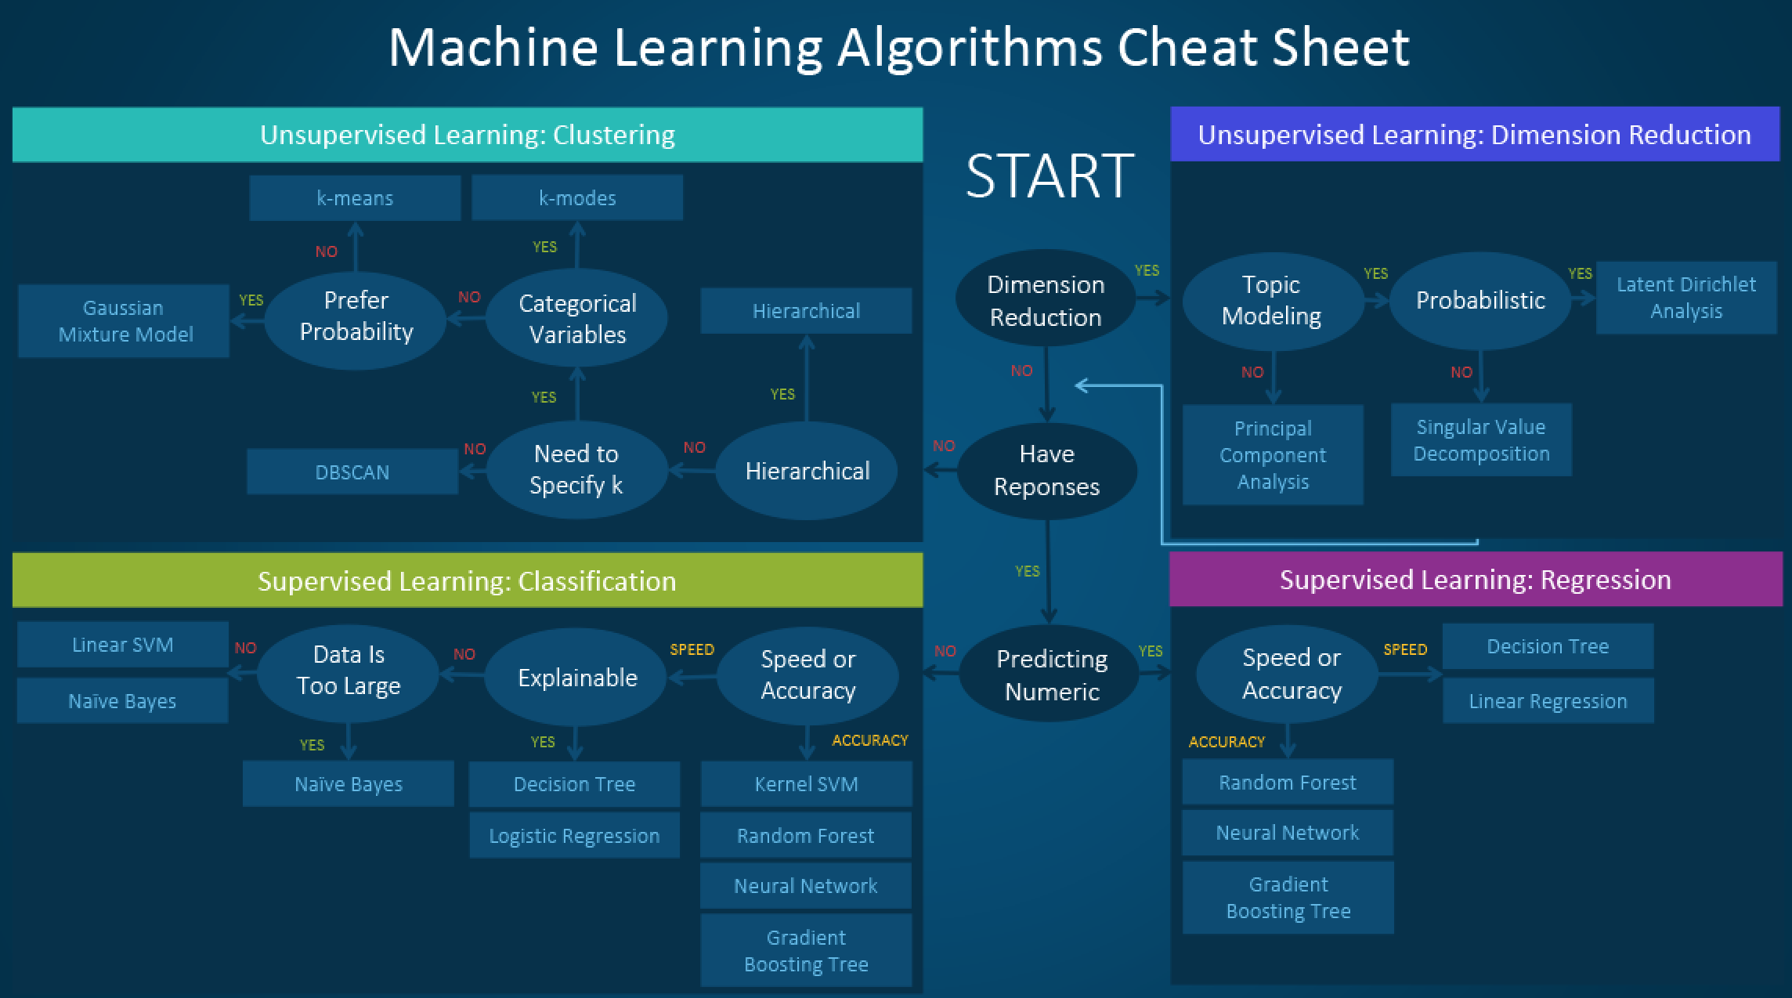
Computer Vision

Slide 29
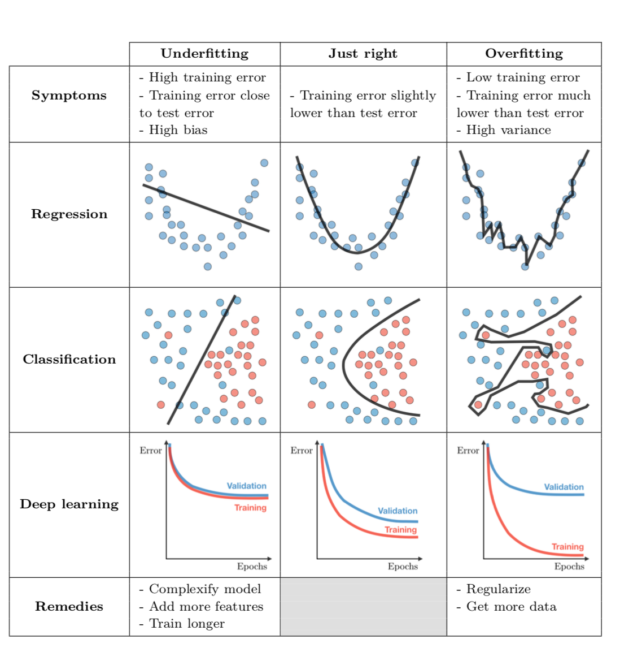
Machine Learning Model Selection

Slide 30
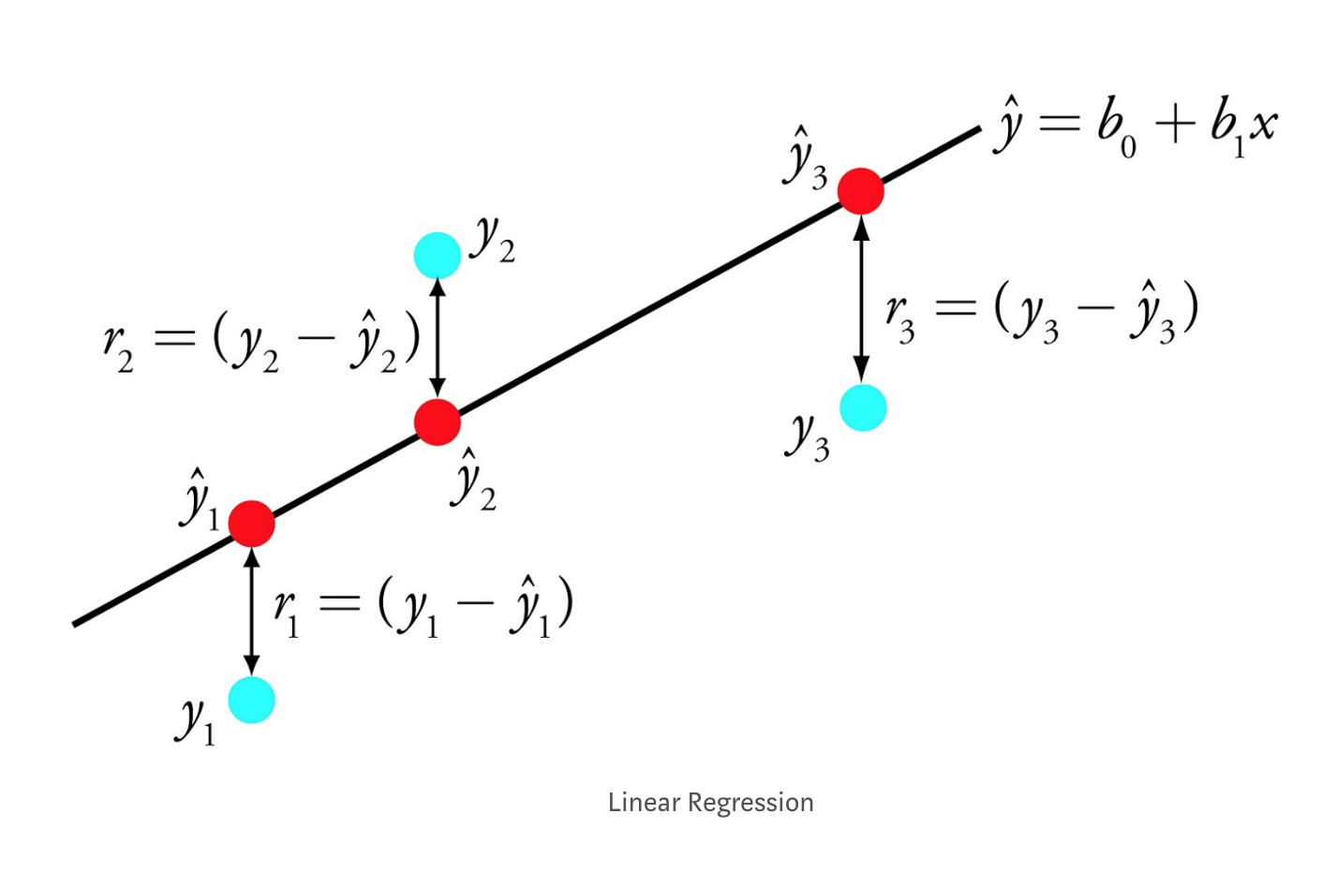
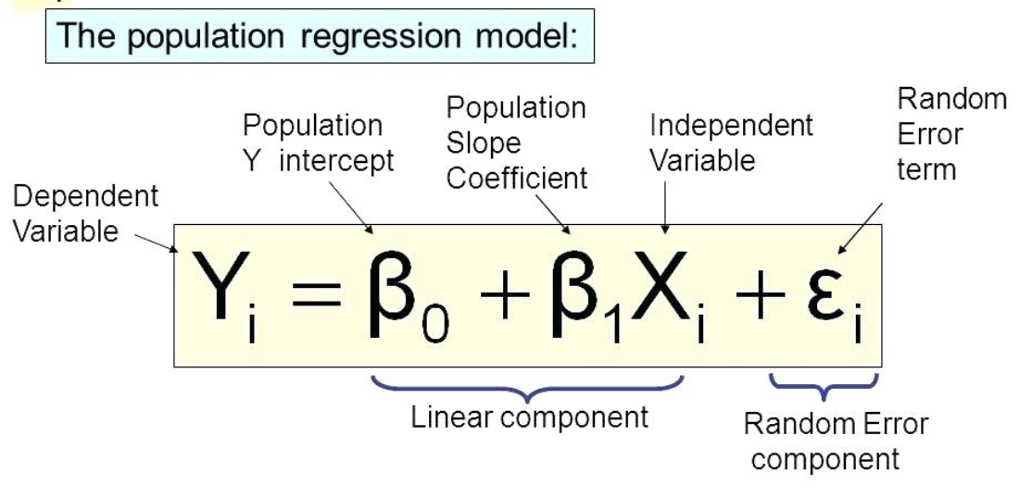
ML Algorithm – Linear Regression

Slide 31
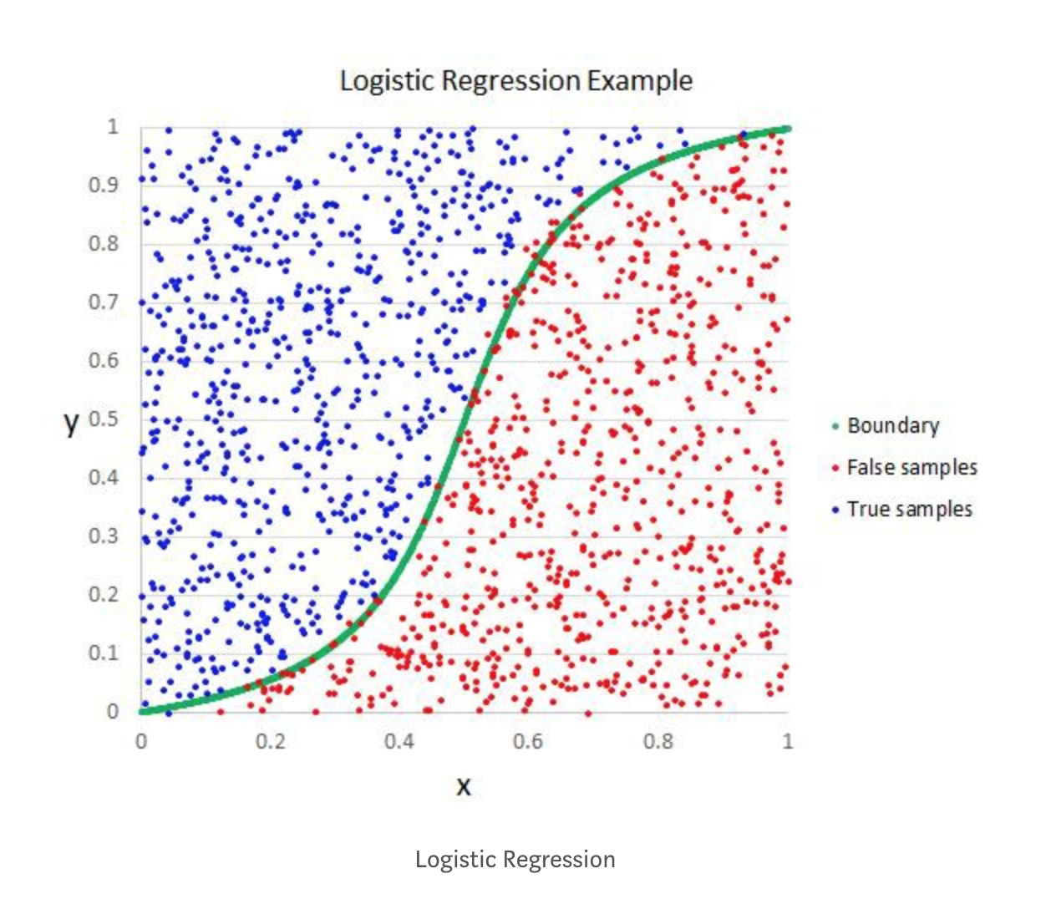
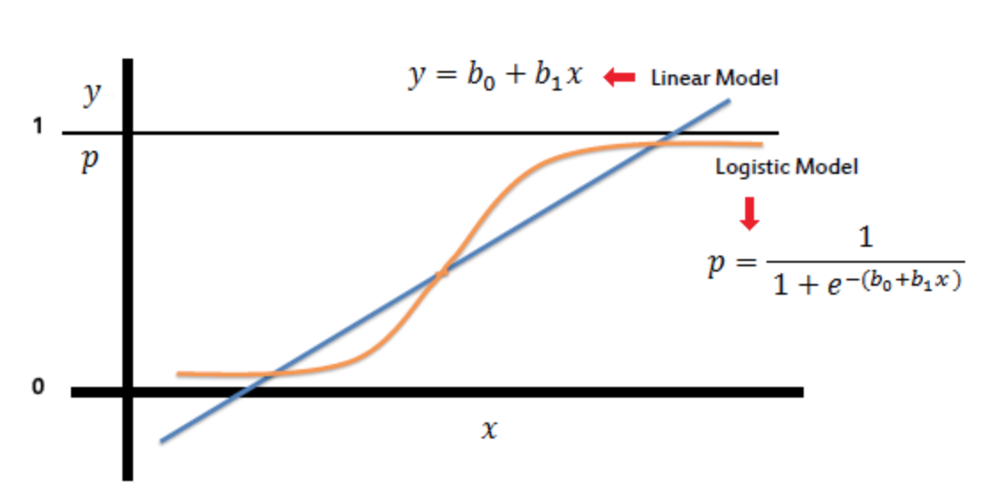
ML Algorithm – Logistic Regression

Slide 32
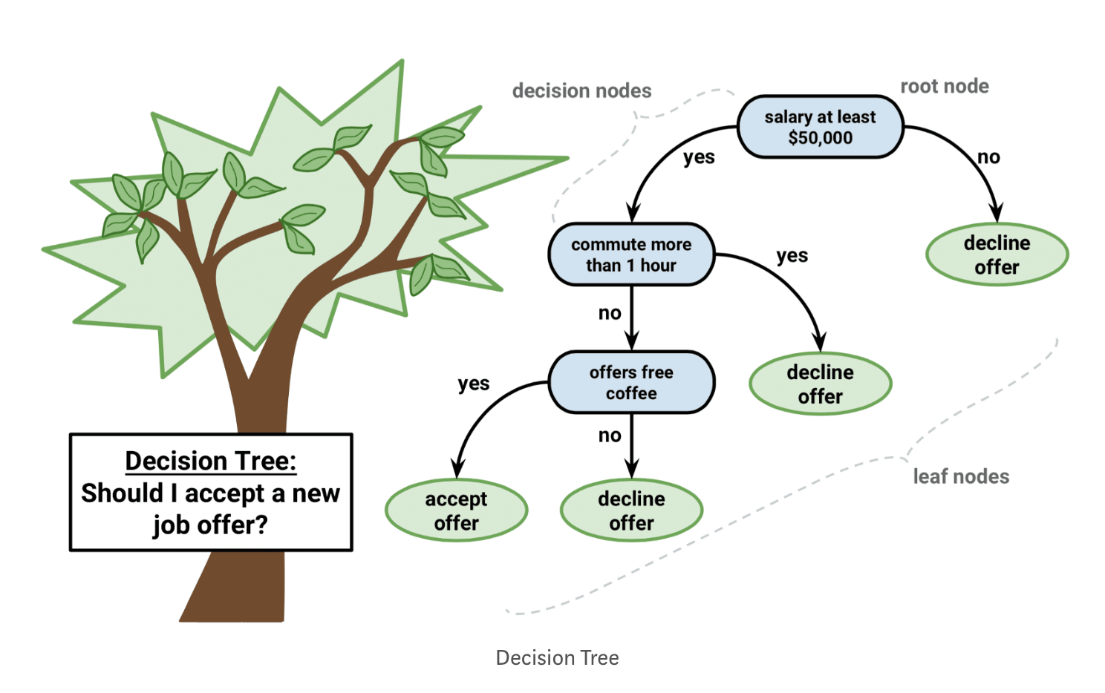
ML Algorithm – Classification and Regression Trees

Slide 33
Deep Learning
Neural Networks and Deep Learning
Improving Deep Neural Networks: Hyperparameter tuning, Regularization and Optimization
Structuring Machine Learning Projects
Convolutional Neural Networks
Sequence Models

Slide 34
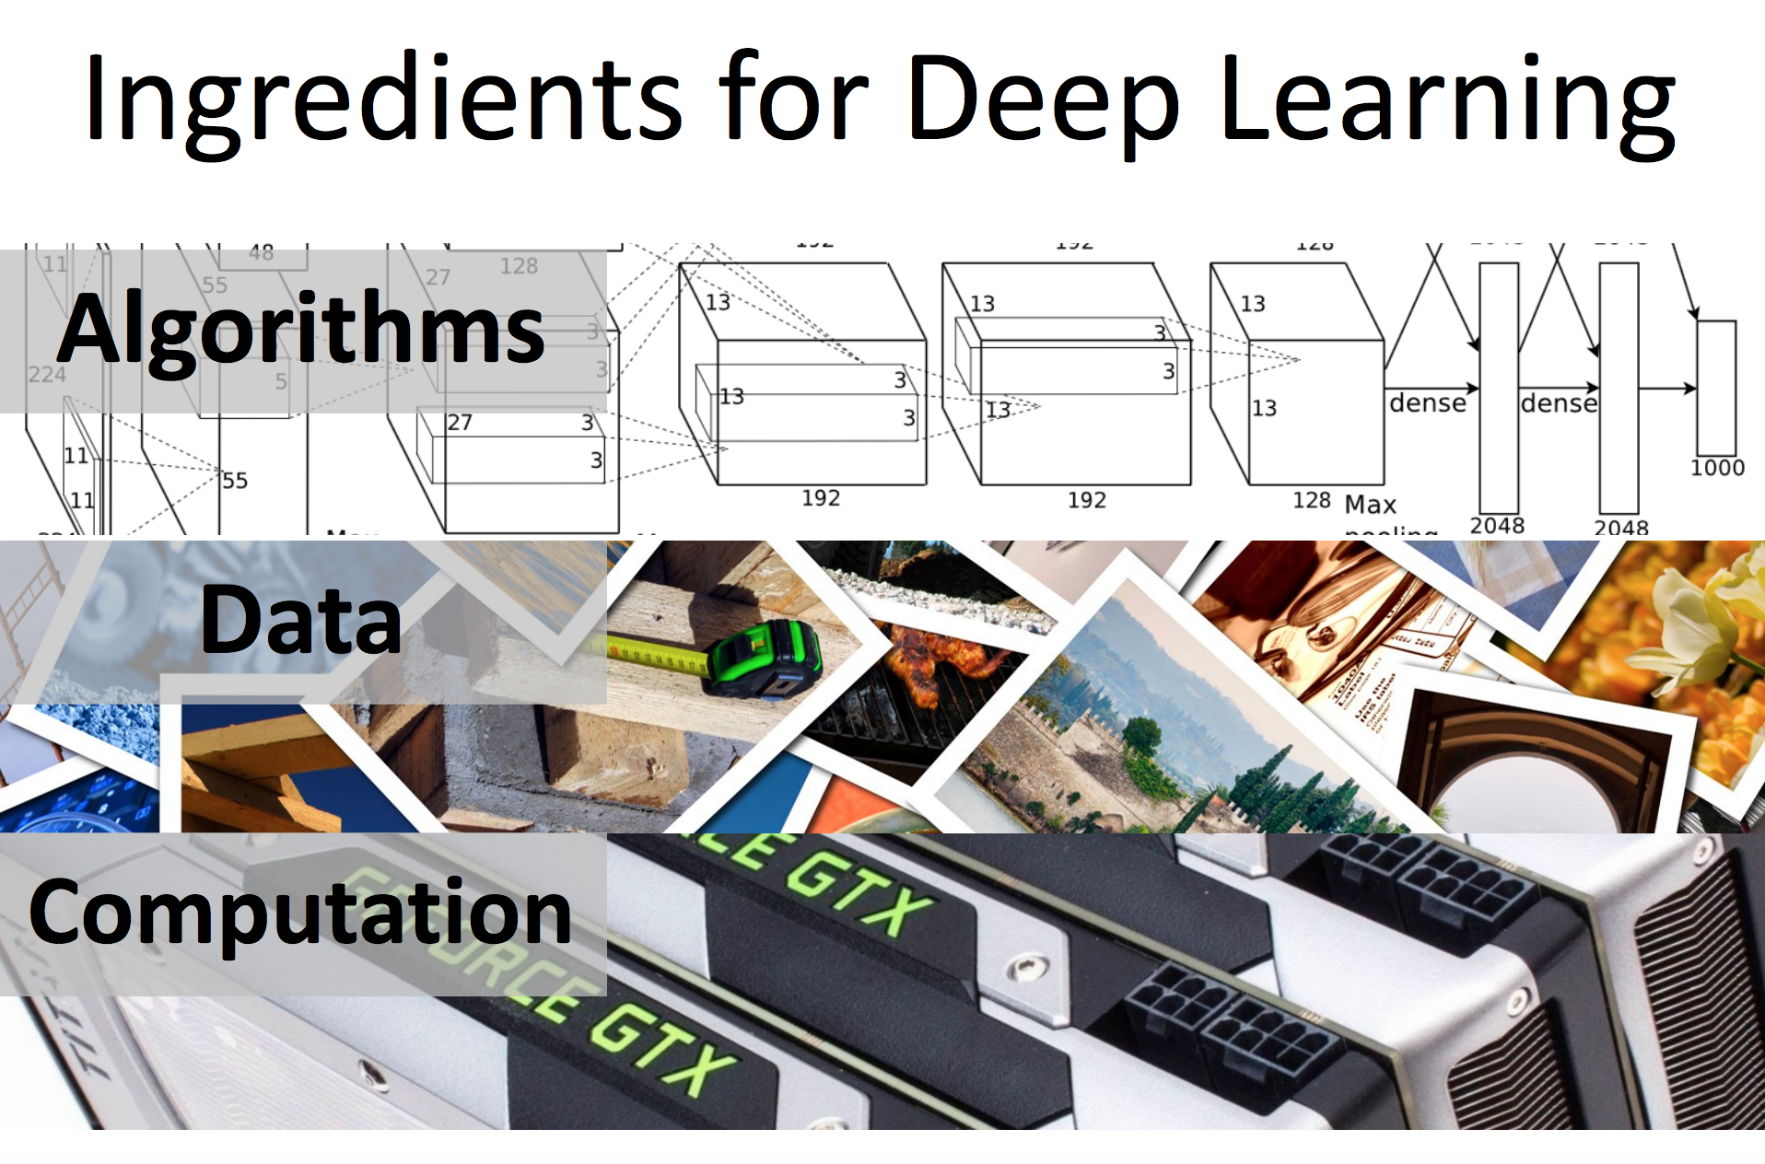
Deep Learning

Slide 35
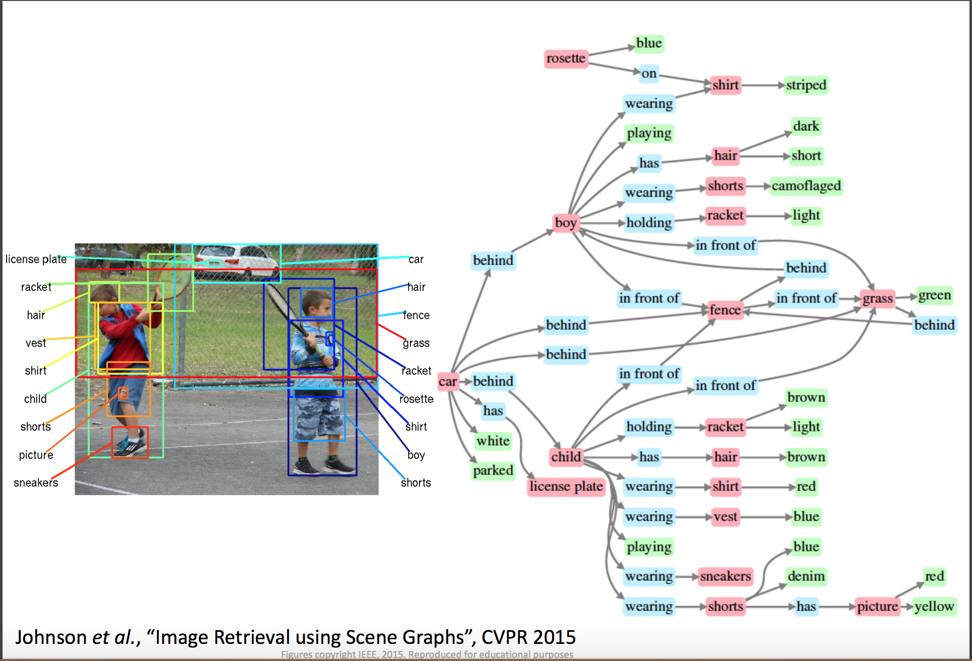
Deep Learning

Slide 36
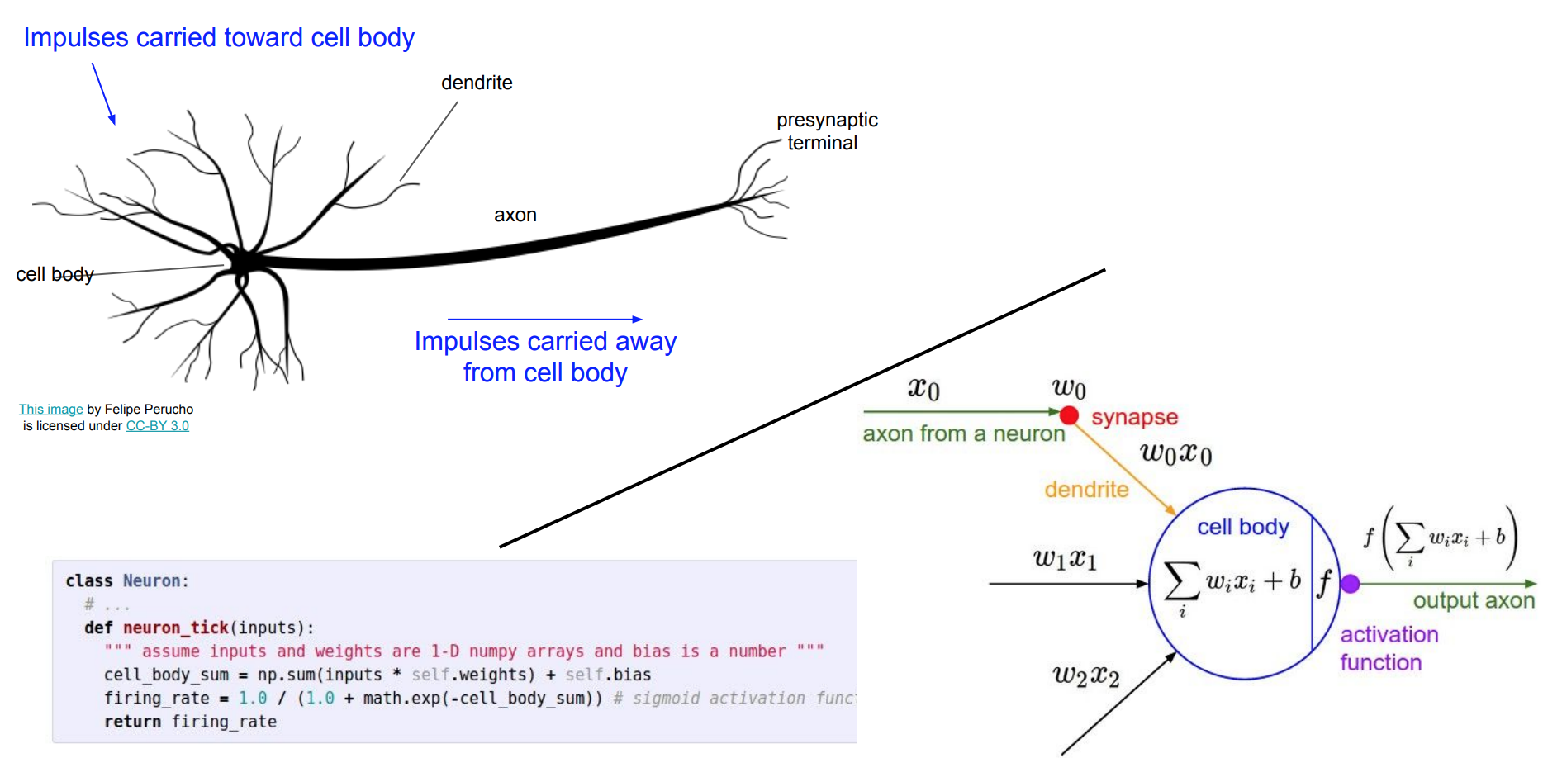
Neural Network

Slide 37
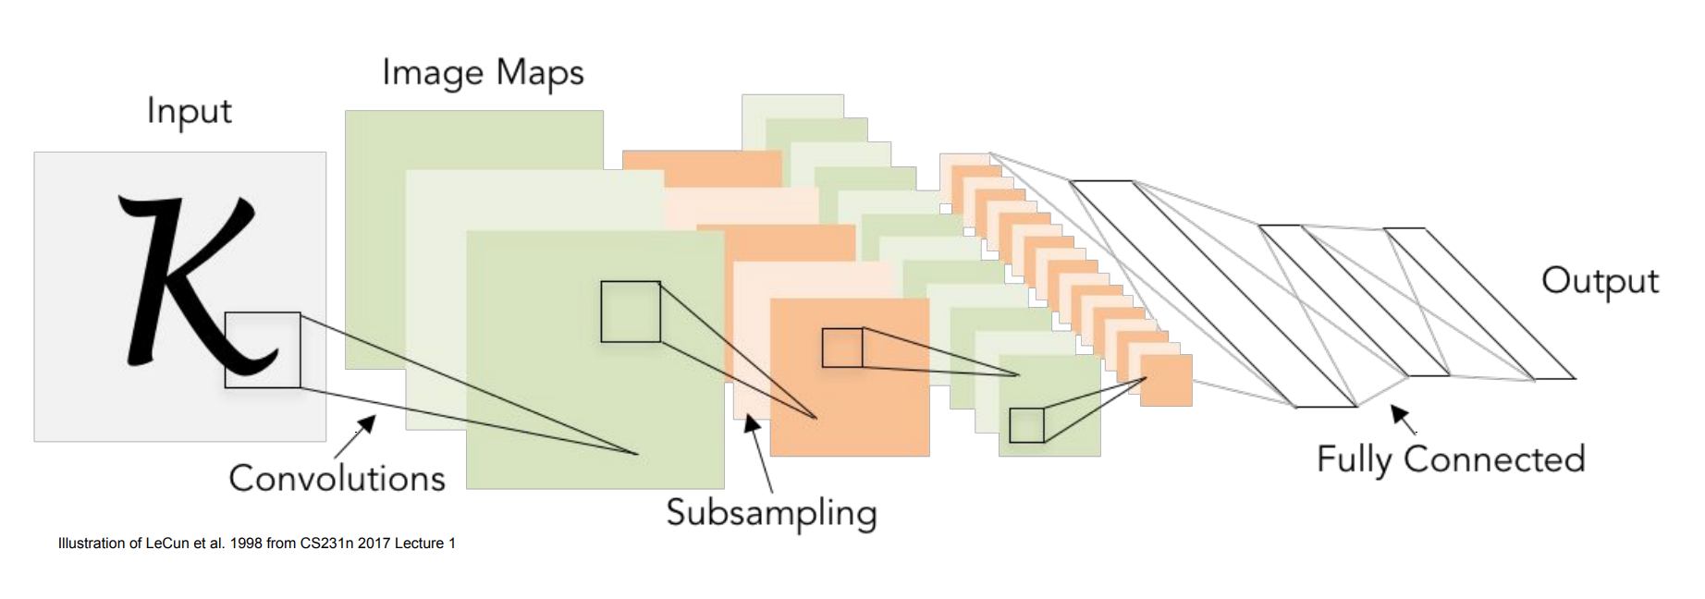
Deep Learning - CNN

Slide 38
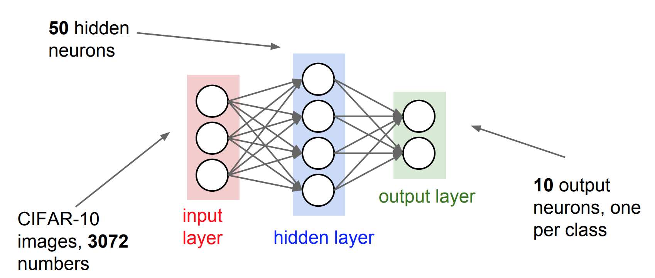
Deep Learning – Neural Network

Slide 39
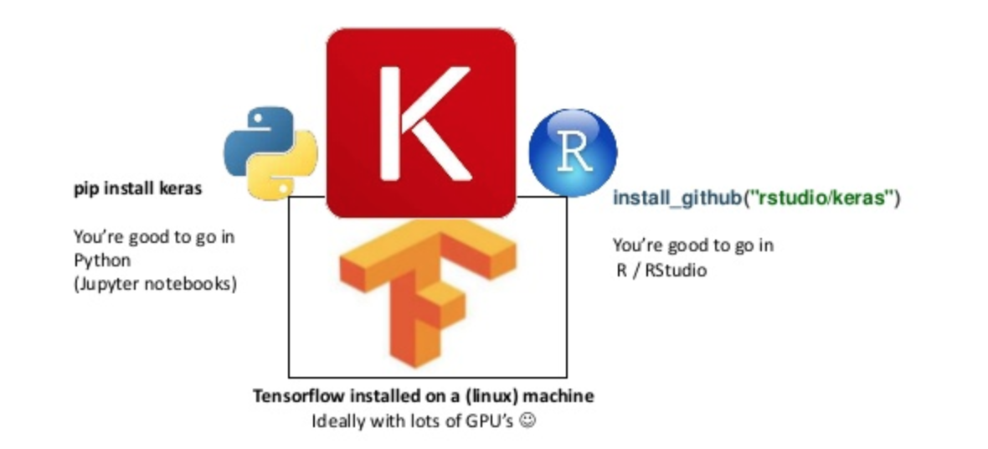
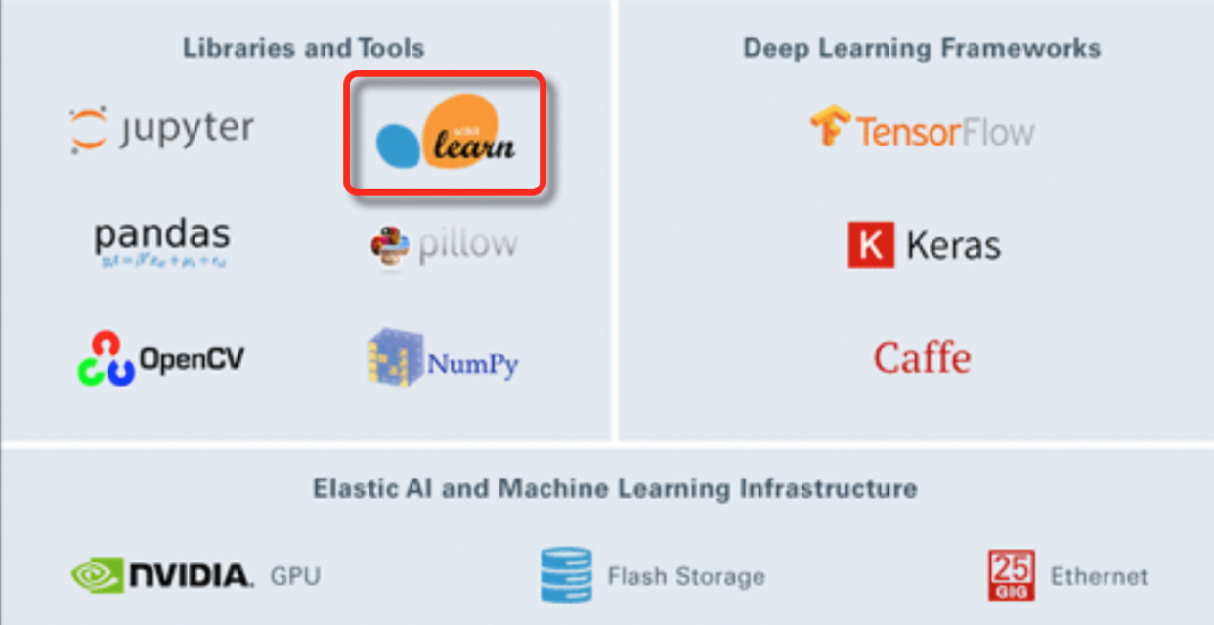
Libraries & Tools

Slide 40
Jupyter Notebook
Project Jupyter is a non-profit, open-source project, born out of the IPython Project in 2014 as it evolved to support interactive data science and scientific computing across all programming languages.
Jupyter will always be 100% open-source software, free for all to use and released under the liberal terms of the modified BSD license.

Slide 41
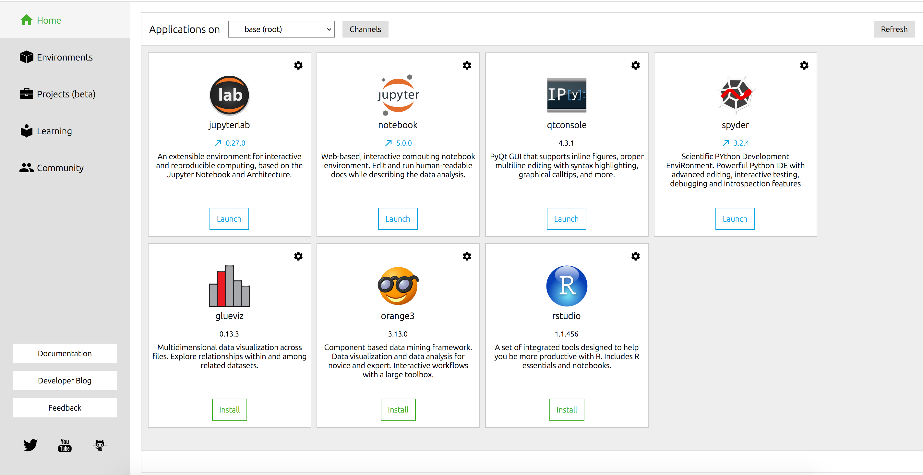
Jupyter Notebook

Slide 42
TensorFlow
TensorFlow™ is an open source software library for high performance numerical computation.
Its flexible architecture allows easy deployment of computation across a variety of platforms (CPUs, GPUs, TPUs), and from desktops to clusters of servers to mobile and edge devices.
Originally developed by researchers and engineers from the Google Brain team within Google’s AI organization, it comes with strong support for machine learning and deep learning and the flexible numerical computation core is used across many other scientific domains.

Slide 43
Basic Classification in TensorFlow – Steps
Import the Fashion MNIST Dataset
Explore the Data
Preprocess the Data
Build the Model
Train the Model
Evaluate Accuracy
Make Predictions

Slide 44
Basic Classification in TensorFlow
Trains a neural network model to classify images of clothing, like sneakers and shirts. It's okay if you don't understand all the details, this is a fast-paced overview of a complete TensorFlow program with the details explained as we go.
This guide uses tf.keras, a high-level API to build and train models in TensorFlow.

Slide 45
Demo in Colab
Colab is the Resource provided by Google to write and test code on web.
https://colab.research.google.com/github/tensorflow/docs/blob/master/site/en/tutorials/keras/basic_classification.ipynb - scrollTo=vasWnqRgy1H4

Slide 46
Learning Math
Linear Algebra
https://www.youtube.com/watch?v=kjBOesZCoqc&index=1&list=PLZHQObOWTQDPD3MizzM2xVFitgF8hE_ab
https://ocw.mit.edu/courses/mathematics/18-06-linear-algebra-spring-2010/
Calculus
https://www.youtube.com/playlist?list=PLZHQObOWTQDMsr9K-rj53DwVRMYO3t5Yr
Probability
https://www.edx.org/course/introduction-probability-science-mitx-6-041x-2
Algorithms
https://www.edx.org/course/algorithm-design-analysis-pennx-sd3x

Slide 47
References & Foundations
Programming
Syntax and basic concepts: Google’s Python Class, Learn Python the Hard Way.Practice: Coderbyte, Codewars, HackerRank.
Linear algebra
Deep Learning Book, Chapter 2: Linear Algebra. A quick review of the linear algebra concepts relevant to machine learning.A First Course in Linear Model Theory by Nalini Ravishanker and Dipak Dey. Textbook introducing linear algebra in a statistical context.
Probability and Statistics
All of Statistics: A Concise Course in Statistical Inference, by Larry Wasserman. Introductory text on statistics.

Slide 48
References & Foundations
Calculus
Khan Academy: Differential Calculus. Or, any introductory calculus course or textbook.
Machine Learning
Andrew Ng’s Machine Learning course on Coursera Data science bootcamps:
Textbook - An Introduction to Statistical Learning by Gareth James et al. Excellent reference for essential machine learning concepts, available free online.
Deep Learning
Deeplearning.ai, Andrew Ng’s introductory deep learning course.CS231n: Convolutional Neural Networks for Visual Recognition, Stanford’s deep learning course. Helpful for building foundations, with engaging lectures and illustrative problem sets.

Slide 49
Conclusion
Introduction to Artificial Intelligence, Machine Learning and Deep Learning
Important Algorithms
Overview of AI/ML/DL
Regular Meetups
Links to Read

Slide 50
Disclaimer
All Images got it from Public websites and authorized to present. No violation of copy rights or plagiarism.

Slide 51

Questions

Slide 52

Thank You

